Slide 1





GROW MATE
Your agricultural partner
Team Members:
Sankit Binkar
Harshal Borkar
Harsh Gathode
Aditya Mate
Rohit Kirpal
Guide:
Akshay Chaskar

Slide 2
OUTLINE
Abstract
Problem Statement
Aims, Objective & Proposed System/Solution
System Design/Architecture
System Development Approach (Technology Used)
Algorithm & Deployment
Conclusion
Future Scope
References
Video of the Project
Notes:
These are the list of chapters that we are going to cover in these foundation codes. Those are chapter one what are AI and ML? chapter 2 applied Python programming in AI, and chapter 3 is exploratory data analysis for ML.

Slide 3
Abstract
This project focuses on developing a machine learning-based crop recommendation system to assist farmers in optimizing their crop selection. The system takes input parameters such as nitrogen, phosphorus, potassium levels, temperature, ph of soil , rainfall and humidity. The algorithm analyzes these factors to recommend the most suitable crop for cultivation. We have compared multiple ML algorithms and got RandomForestclassifier as best option. It also recommends best fertilizer for the crop along with a brief description about it. The proposed system aims to enhance agricultural decision-making, promote sustainable farming practices, and ultimately contribute to improved crop yield and resource utilization.

Slide 4
Problem Statement
Farmers face challenges in optimizing crop selection to maximize yield while efficiently utilizing resources. Existing methods often lack precision and fail to account for various environmental factors. This project addresses the gap by proposing a machine learning-based crop and fertilizer recommendation system. It is also difficult to identify Disease and it's cure. Its' also difficult to find expert help for this.

Slide 5
Aim and Objective
AIM:
To revolutionize the agricultural landscape by providing a online platform that empowers farmers with cutting-edge information and tools. Our aim is to encourage sustainable farming practices, bridge the gap between traditional and innovative methodologies, and cultivate a thriving community that embraces technology for the betterment of agriculture.
OBJECTIVES:
Precise Agriculture Guidance
Integrated Disease Management
Showcasing New Cultivation Techniques & Technologies
Government Scheme & Subsidies Information
Continuous Improvement and Innovation
Sustainable Agriculture Advocacy
User-Friendly Platform

Slide 6
Proposed Solution
Empowering Agriculture for a Sustainable Future
Implement an advanced recommendation system that utilizes precision agriculture and environmental factors for providing farmers with tailored guidance on crop selection, planting, and optimal fertilizer use.
Introduce an intelligent disease detection module, coupled with a comprehensive database of prescribed supplements. This solution enables farmers to identify and manage crop diseases effectively, minimizing losses and enhancing overall crop health.
Establish a dedicated section showcasing the latest cultivation technologies. Regularly update information on precision farming, and other innovative practices to empower farmers with knowledge for sustainable and efficient farming.
Develop a centralized and up-to-date repository of government schemes and subsidies relevant to the agricultural sector. This resource ensures farmers have easy access to information, streamlining the application process and maximizing benefits.
Actively promote sustainable agricultural practices through educational content. Encourage farmers to adopt environmentally friendly approaches that enhance long-term soil health and contribute to overall ecosystem sustainability.

Slide 7
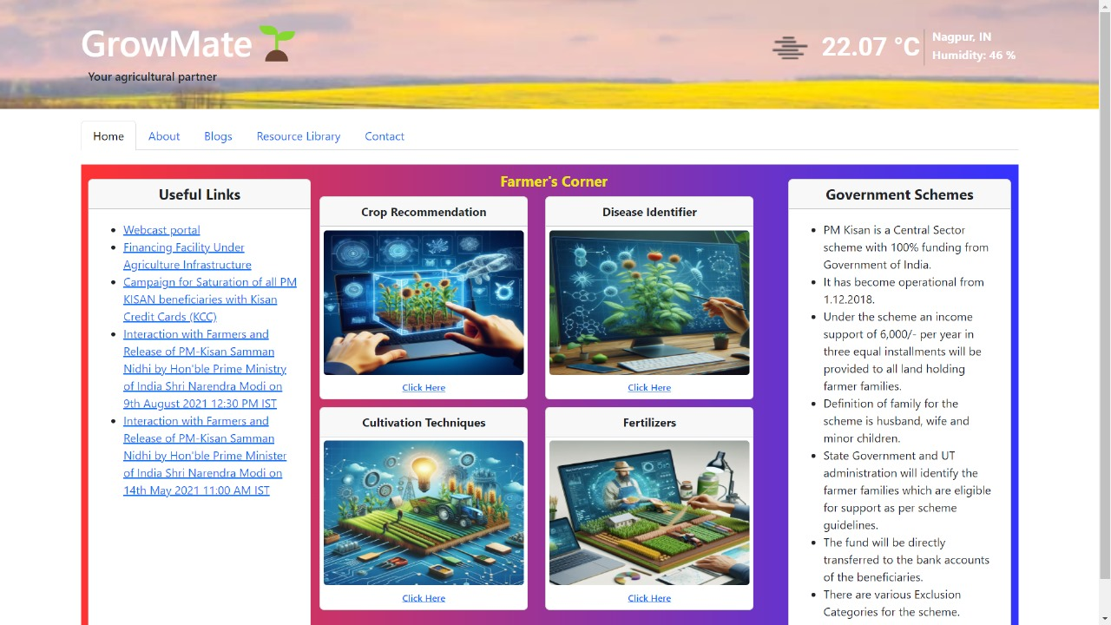
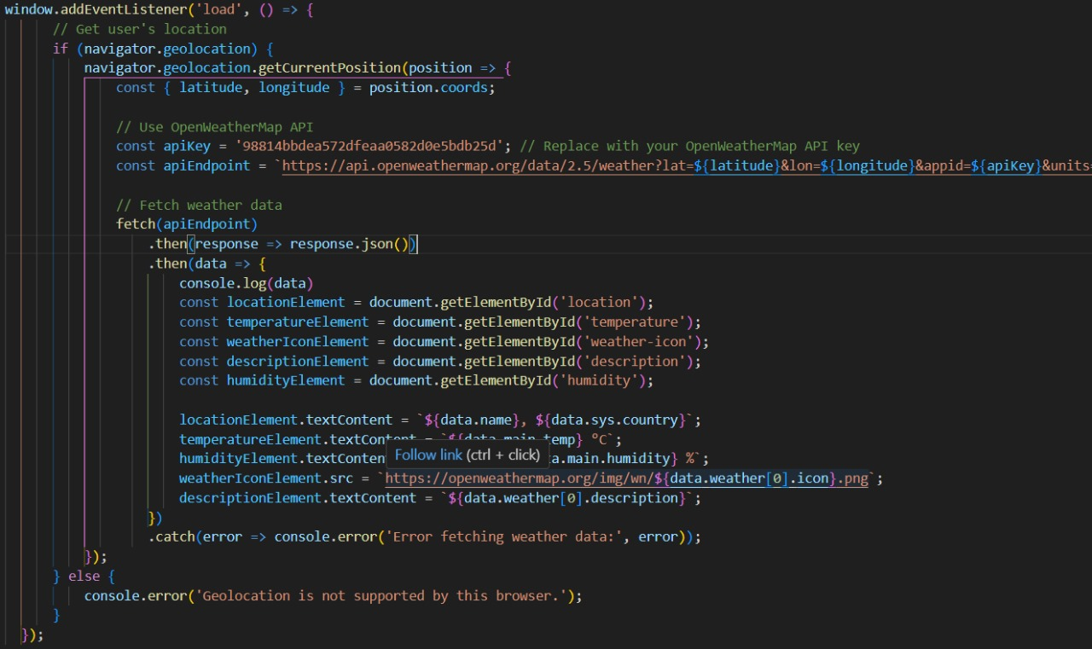
System Architecture

Slide 8
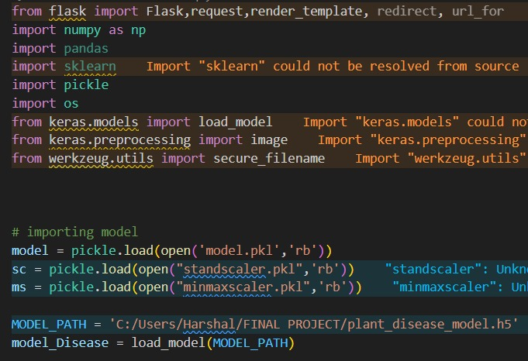
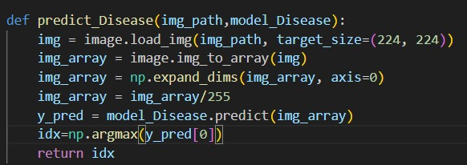
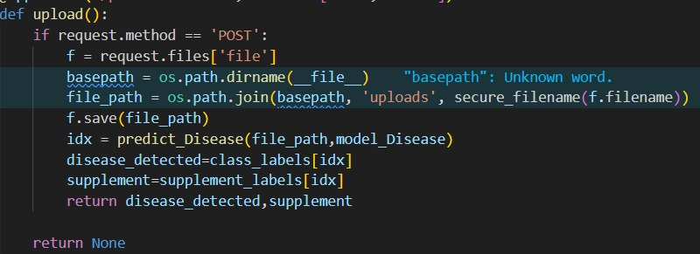
System Deployment Approach

Slide 9
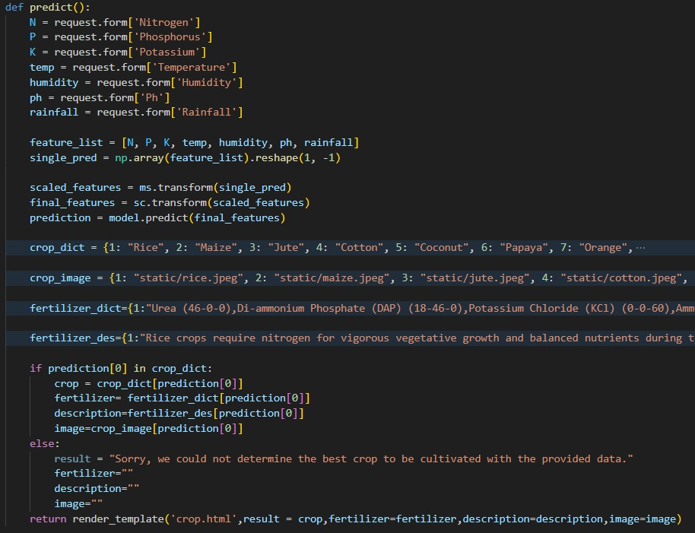
Algorithm & Deployment

Slide 10
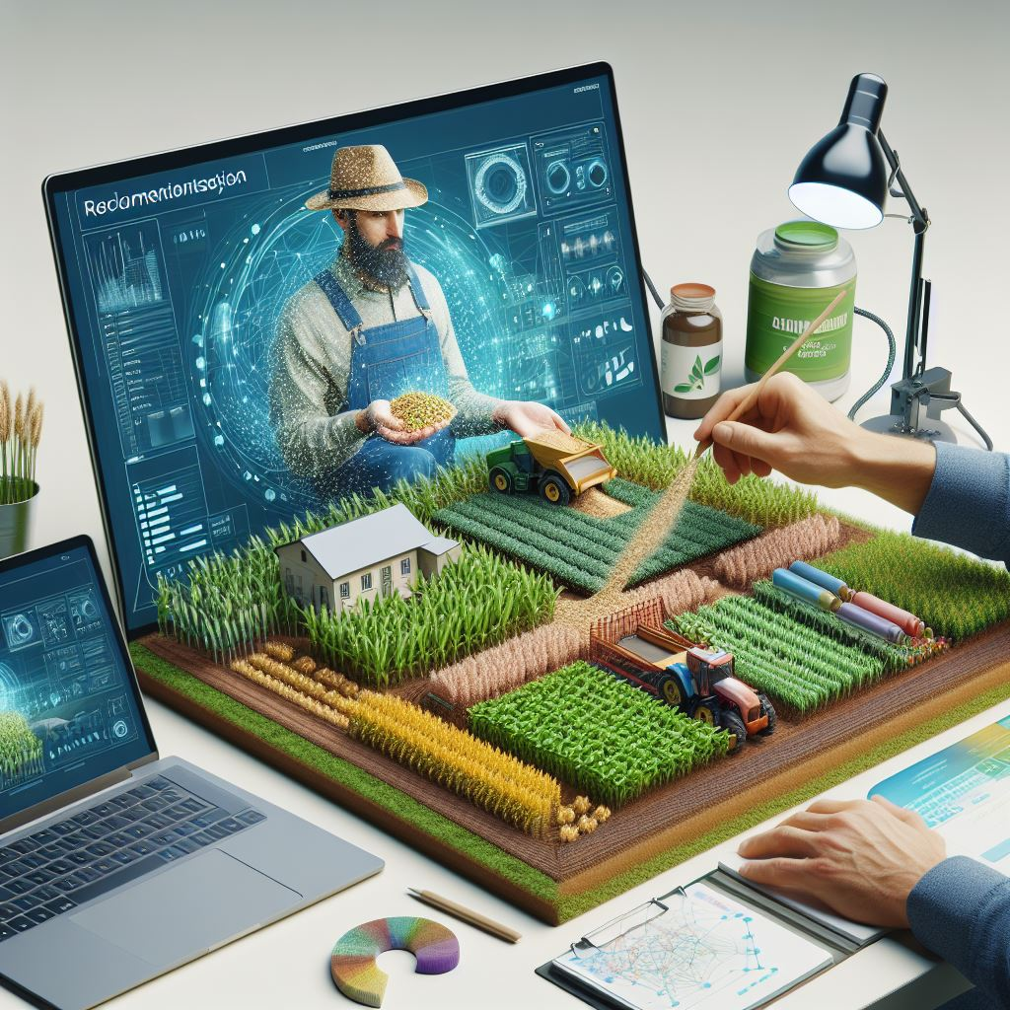
Conclusion

Slide 11
Future Scope
Include land type for predicting best crop.
Focusing more on organic farming methods with new cultivation techniques.
Chatbot and Resource library.
Access to Government schemes and subsidies easily.

Slide 12
Reference
http://www.oreilly.com/data/free/the-new-artificial-intelligence-market.csp
Notes:
Reference
These are the references for this session.
12

Slide 13
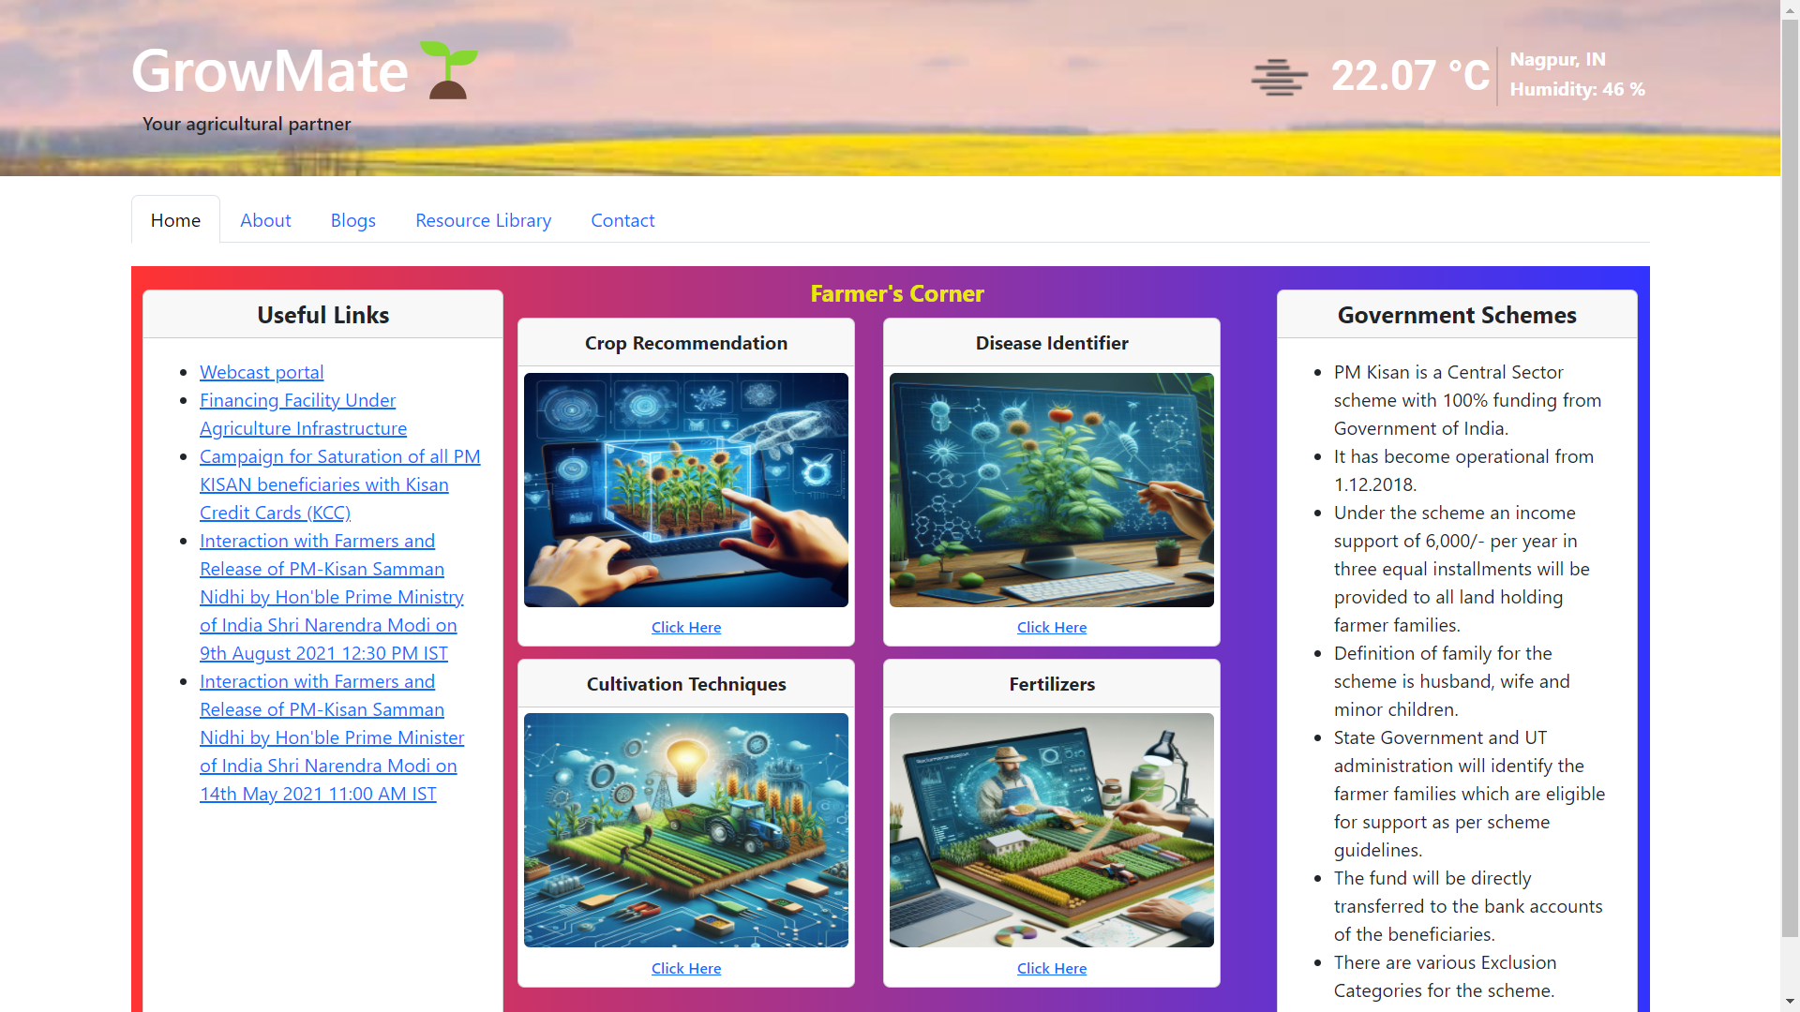

Slide 14
Thank you!
Notes:
thank you very much for joining this PPT, keep learning.
14

